Slide 1
Personalized Academic Planner [PAP]
Tolani Oke-Steve 200429404
Bilal Alissa 200384288
Week 14
November 27, 2023
Software Engineering Management (ENSE 374)

Slide 2
Agenda
Introduction
Problem Definition
Design Requirements
Solutions
Project Management
Conclusion and Future Work

Slide 3
Introduction
Project Name: Personalized Academic planner [PAP]
Project Description
Notes:
Project Description
The project is centered around the design and development of a Personalized Academic Planner (PAP). Which developed with the intent to help students become more effective at managing their time, reduce stress from their course load, and develop better study habits that will help them get better grades.
The rationale behind this project comes from the increasing demands and challenges students face when managing their academic responsibilities. The PAP's goal is to give students a customized planner that fits their individual needs by letting them alter it according to their courses, due dates, and study styles. It is anticipated that this personalized approach will improve students' motivation, engagement, and general academic achievement.

Slide 4
Problem Definition
Students Challenges
Scheduling
Tracking due dates/ Assignments
Failing classes
Financial Challenges
Notes:
Students Challenges & Scheduling
The problem that the PAP aims to solve is the difficulties students often face when managing their academic tasks and schedules such as lack of poor task management skills, Poor Scheduling of activities to do.
Tracking due dates/ Assignments & Failing classes & Financial Challenges
keeping track of due dates and assignments, failing classes due to poor management of class activities and financial challenges that arise from failing/ redoing classes. PAP aims to help in solving this problem by keeping track of assignments, Tracking activities and their due dates, exams and other academic responsibilities and to foster the development of better study habits that can lead to better academic performance.

Slide 5
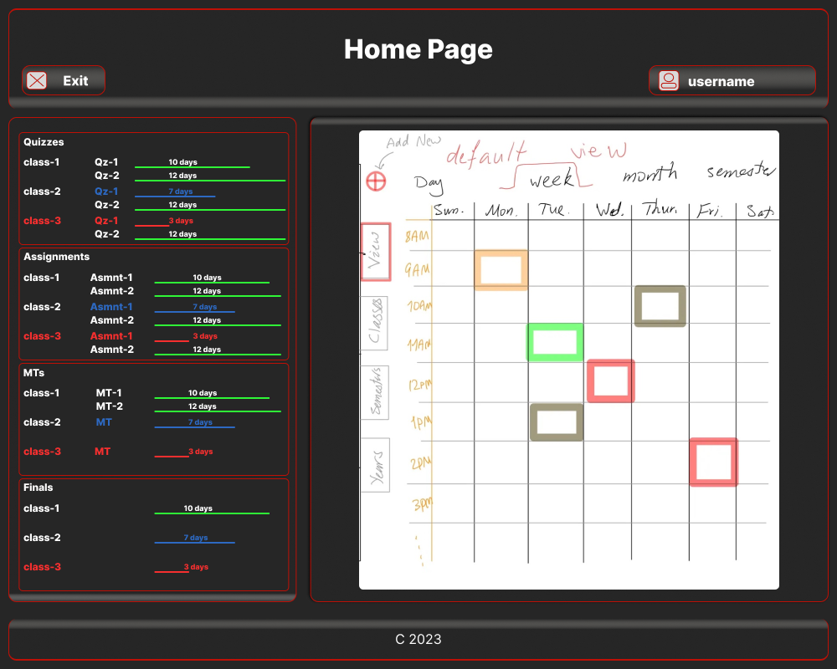
Design Requirements
Function
Task Management
Notes:
The PAP should allow users to seamlessly edit, add new tasks and view deadlines. Under function in design requirements

Slide 6

Design Requirements
Function
Notifications
Notes:
Remainders and alarms about upcoming tasks should be sent to users on the PAP or their cellphone devices (under development)

Slide 7
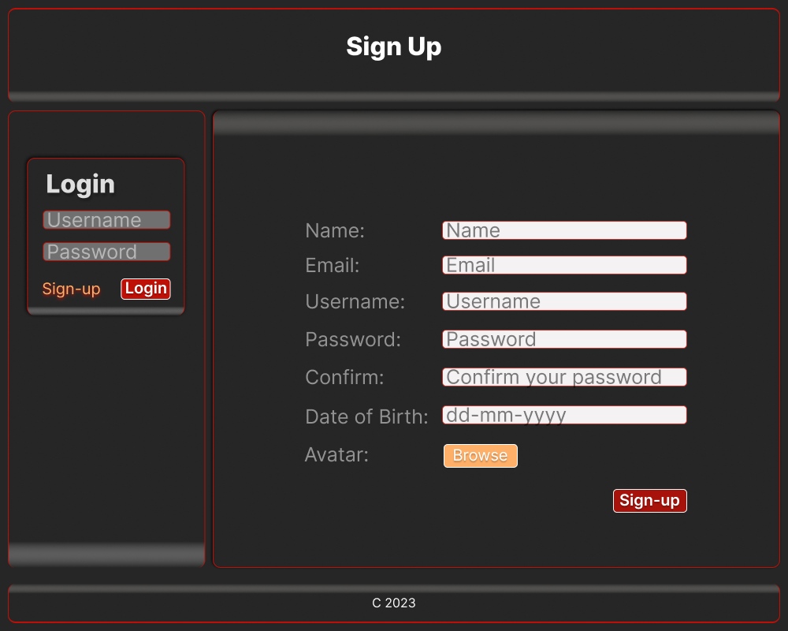
Design Requirements
Function
User Registration and Login.
Notes:
Users should be able to register and login to the PAP using their information to see their tasks assignment and duties.

Slide 8
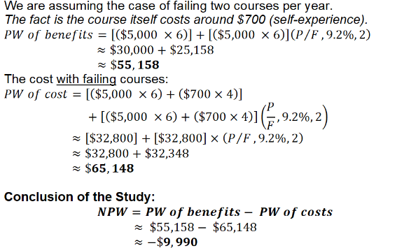

Design Requirements
Objectives
Reduce Stress.
Enhance productivity.
User-Friendly.
Increase Accountability
Notes:
Reduce student’s Stress:
Through the provision of a well-defined timetable and tasks overview, the PAP seeks to relieve the stress that comes with managing and remembering what activities are due and what activities they need to prepare for.
Enhance productivity:
The PAP aims to help users improve their productivity by helping them manage their time effectively and complete activities on time.
User-Friendly:
The PAP should be intuitive and easy to navigate, even most importantly for first-time users
Increase Accountability:
To make students using the PAP more accountable for their tasks and deadlines, promoting a sense of responsibility among students.
For the picture on the right this presents the benefit of the PAP to students as it is cost effective to users during their school-term which in turn relives their stress and helps them achieve overall academic success

Slide 9
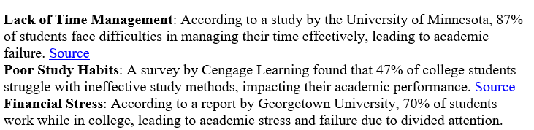
Design Requirements
Constraints
Ethical constraints
Economic Constraints
Societal Impact
Sustainability and Environmental Factors
Notes:
Ethical constraints:
When logging in or out, the PAP should guarantee user security and data protection.
Economic Constraints:
The development of the PAP should be cost effective using less lines of code as shown in the excel file the financial cost is zero and the time cost is high (because we are students with more projects, assignments and exams hence the high cost).
Societal Impact:
The PAP should aim to have a positive impact on students by improving their academic success.
Sustainability and Environmental Factors:
The production of the PAP should carried out in a sustainable manner and for this we would ensure that we use servers with low carbon footprint e.g. Greenhost
More attention should be paid to using servers that are environmentally friendly and have a low carbon footprint when creating and running the PAP

Slide 10


Solutions
Task Management
Notifications (Under Development)
Ethical Constraints
Economic Constraints
Societal Impact
Notes:
Task Management:
Design and Implementation: The PAP's user-friendly interface makes it simple for users to add, edit, and remove tasks.
Analysis: This feature guarantees that customers can keep their task lists organized and modified in accordance with their changing academic requirements.
Notifications:
The PAP sends reminders for upcoming tasks to users. Vibrations sent to user’s cellphone devices
Analysis: By acting as early reminders, notifications lower the chance of deadline missing deadlines and improve time management.
Ethical Constraints:
Safe user authentication and data security are ensured by the PAP.
Analysis: Addressing ethical constraints is crucial for user compliance with data protection laws.
Economic Constraints:
The development process focuses on using less lines code for the same functionality.
Analysis: Prioritizing economic constraints aligns with resource optimization, ensuring a sustainable project.
Societal Impact:
The PAP aims to positively impact students by improving their academic success.
Analysis: The project's overall objective of improving users' academic experiences is in line with the societal impact.

Slide 11





Project Management
The PAP was designed to follow these steps:
Planning
Production
Testing
Delivering
Notes:
Planning: Getting what will needed for the application and conducting a feasibility analysis
Production: Implementing of the Functionalities of the PAP using Requirements document.
Testing: Final testing of the PAP to ensure it meets all its requirements and it fit of its purpose.
Delivering: Releasing the PAP to end users
Gantt Chart:
Problem definition (week 1-4): Clarifying objectives and establishing user requirements.
Requirement gathering Analysis(week 5-8): Define clear objectives and analyze how they can be achieved.
Implementation ( week 9-13): Start the coding process, create the database, and implement the front-end and back-end.
Review/ Testing (week14): Test the PAP for any bugs or issues and ensured it met all predefined requirements.
Delivering (week14): release of the PAP for use.

Slide 12
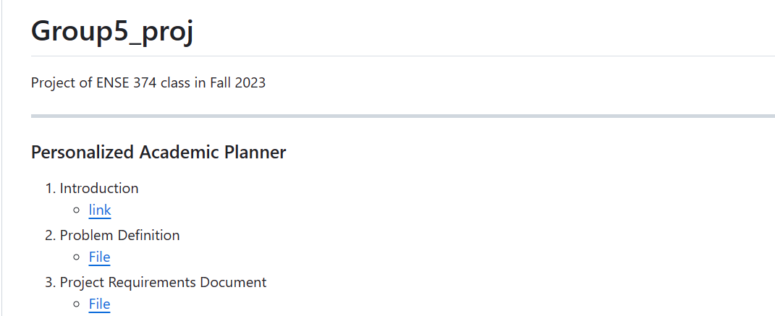
Project Management
Planning (Github) => Readme
Notes:
Planning: The processes above highlights the planning process of this application to attain what is required for the PAP

Slide 13


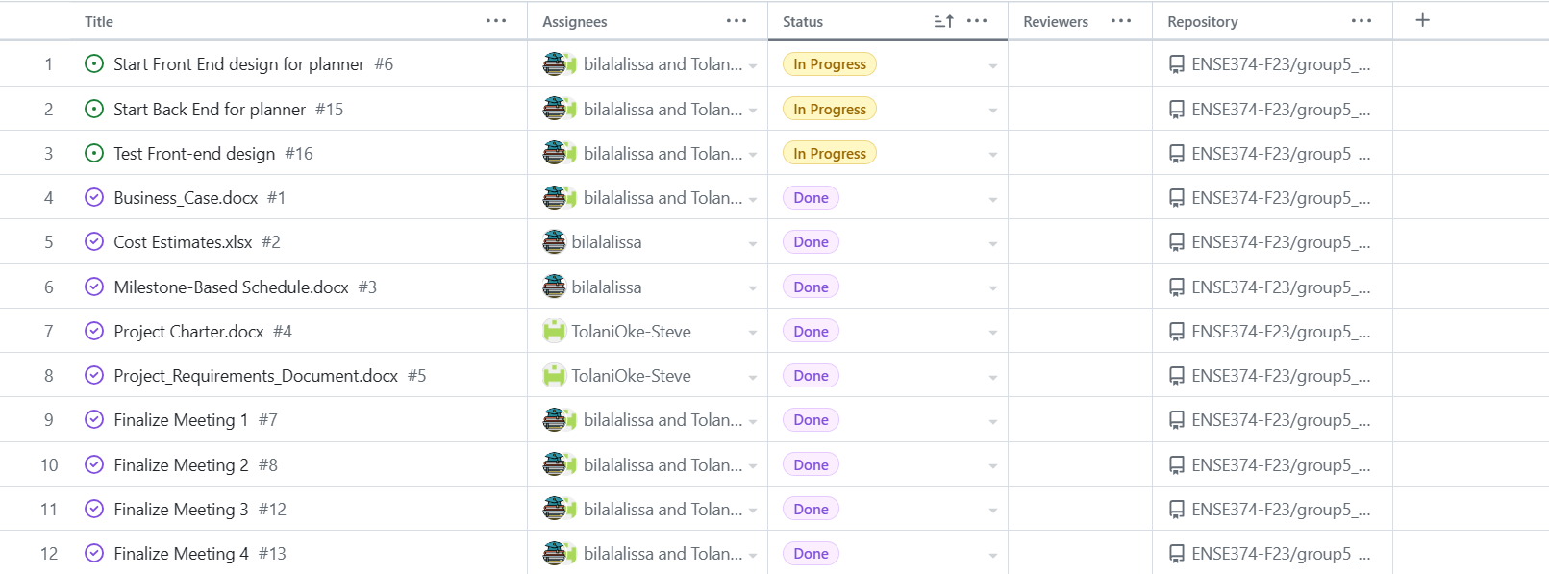
Project Management
Production (Github) => Kanban
Notes:
Production: The example above are the steps showing how the production was carried out when developing the PAP.

Slide 14
Conclusion and Future Work
Import feature.
Classes Schedule
Collaborative Feature
Notes:
The Personalized Academic Planner (PAP) has shown significant potential in addressing the common challenges students face in managing their studies.
By providing a customizable platform that caters to individual needs, courses, and study styles, it is anticipated that the PAP will enhance student motivation, engagement, and overall academic achievement.
Import feature:
The PAP could be integrated with the University of Regina software to allow students to directly import all their term activities from the u of r database. This could streamline the task management process for students.
Class schedule:
In future Versions the PAP would have the option to create a whole schedule of user activities.
Collaborative Features:
Future versions of the PAP could include features that allow students to collaborate on tasks, share their schedules, or study together virtually. This could foster a sense of community and shared learning

Slide 15
Demo and Q&A

